Slide 1
XHTML III

Slide 2
Stylesheets
A stylesheet is a set of rules governing how the browser "renders" the contents of HTML tags.
HTML historically has focused on content rather than style.
Stylesheets enable a consistent "look" across multiple documents.
Stylesheets can help with web accessibility. For example alternative stylesheets can be produced for those suffering colour-blindness or dyslexia.

Slide 3
Types of Style Sheet
Cascading Style Sheets (CSS)
  Standardised by W3C
  Draft proposal for CSS Standard in 1996.
  IE4 & Netscape 4 onwards comply with CSS Standard.
  Extended to CSS2 standard in 1998.
  Browsers do not yet fully comply with CSS2 standard.
Javascript Style Sheets (JSS)
  Specific to Netscape.
  Some advantages such as dynamically generating styles.
  Should generally be avoided.

Slide 4
Cascading Style Sheets
There are three methods of adding style rules to HTML:
  Inline styles using the style attribute.
  Document level style sheets using the <style> and </style> tags.
  External style sheets where the style rules are linked or imported from a separate file.

Slide 5
Inline Styles
<h1 style="color:blue; font-style: italic">First Stylesheet Example</h1>
<p>The first example of stylesheets uses an inline style.</p>
<h1>Second Stylesheet Example</h1>
<p>The second example of stylesheets uses a document-level style.</p>
<h1>Third Stylesheet Example</h1>
<p> The third example of stylesheets uses an external stylesheet.</p>

Slide 6
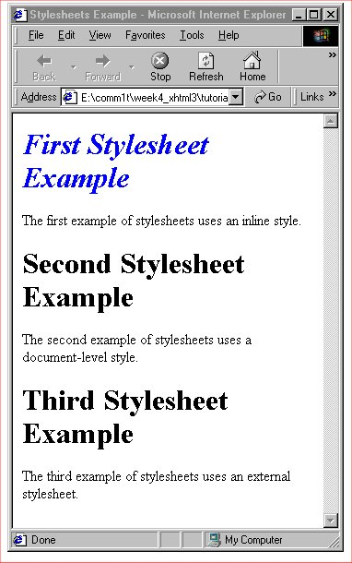
Demonstration: inline_css.html

Slide 7
Document-Level Style Sheet
<head>
<title>Stylesheets Example 1</title>
<style type="text/css">
<!--
/* make all level-1 headers red and italic */
h1 {color: red; font-style: italic}
-->
</style>
</head>
This will affect all h1 style headings in the document.

Slide 8
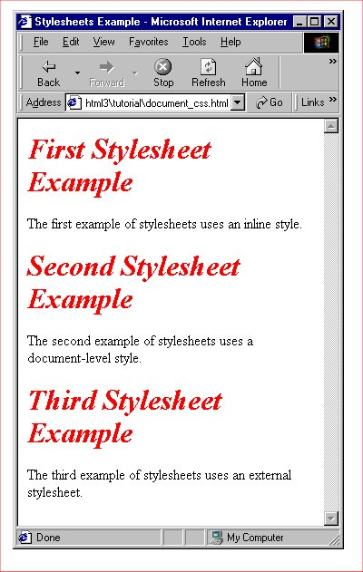
Demonstration:
document_css.html

Slide 9
External Style Sheet
Styles are contained in a separate file (in this case called gen_styles.css)
/* make all level-1 headers red and italic */
h1 {color: red; font-style: italic}

Slide 10
Linking to an external style sheet
<head>
<title>Stylesheets Example</title>
<link rel=stylesheet href=gen_styles.css type=text/css>
</head>
This link should be included in any HTML document which uses the stylesheet.
This method works in both Netscape and Internet Explorer.

Slide 11
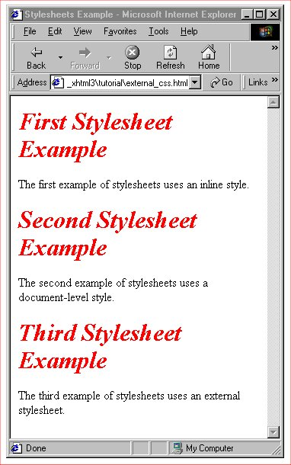
Demonstration:
external_css.html

Slide 12
Imported external style sheet
<head>
<title>Stylesheets Example</title>
<style>
<!--
@import "gen_styles.css";
-->
</style>
</head>
This method is not supported by Netscape 4.
It does however work in Internet Explorer 5.

Slide 13
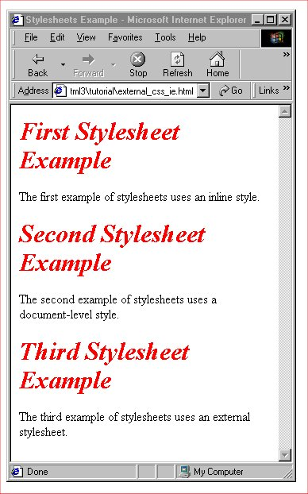
Demonstration:
external_css_ie.html
<html><head>
<title>Stylesheets Example</title>
<style>
<!--
@import "gen_styles.css";
-->
</style>
</head>
<body>
<h1>First Stylesheet Example</h1>
<p>The first example of stylesheets uses an inline style.</p>
<h1>Second Stylesheet Example</h1>
<p>The second example of stylesheets uses a document-level style.</p>
<h1>Third Stylesheet Example</h1>
<p> The third example of stylesheets uses an external stylesheet.</p>
</body>
</html>

Slide 14
Linked versus imported style sheets
The CSS2 Standard for linked style sheets:
  If there are multiple linked style sheets the browser should present the user with a list to select from.
The CSS2 Standard for @imported style sheets:
  Multiple stylesheets are merged to form a single set of rules for the document.
  Cascading effects occur if there is a conflict of rules. i.e. the later style takes precedence.
In practice browsers currently treat linked style sheets the same as imported style sheets - with cascading effects.

Slide 15
Style Precedence
One or more external style sheets can be combined with document-level and in-line styles.
Effects cascade as follows (in order):
  The style closest to the tag takes precedence. e.g. an in-line style over a document style over an external style.
  Properties defined as a class of a tag take precedence over those defined for a tag in general.
  Properties for a more specific contextual style take precedence. e.g. the style for an <ol><li> takes precedence over <li> on its own.
  If there is still a conflict the property defined latest takes precedence.

Slide 16
Multiple Style Sheet example
gen_styles.css:
  /* make all level-1 headers red and italic */
  h1 {color: red; font-style: italic}
background_styles.css:
  /* make background colour red, text colour white */
  body {background: red; color: white}
  /* make all level-1 headers yellow */
  h1 {color: yellow}

Slide 17
Linking to the multiple style sheets
<head>
<title>Stylesheets Example 1</title>
<link rel=stylesheet href=gen_styles.css type=text/css>
<link rel=stylesheet href=background_styles.css type=text/css>
</head>
background_styles.css will take precedence where conflict occurs in colour of h1 style.

Slide 18
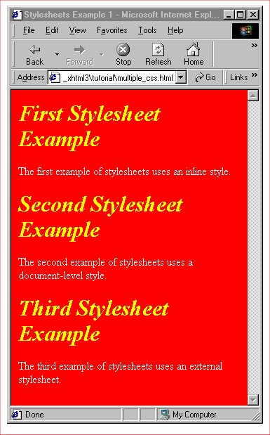
Demonstration:
multiple_css.html

Slide 19
Media specific styles
CSS2 provides the ability to define different styles for different types of device rendering the document:
  all, aural (e.g. speech synthesizers),
  braille (tactile), embossed (braille printers),
  handheld, print, projection, screen,
  tty (fixed-width fonts), TV.
Netscape does not currently support this feature.
Internet Explorer does provide support.

Slide 20
Internet Explorer only!
@media screen
{
body {background: green; color: white}
h1 {color: yellow}
}
@media print
{
body {background: white}
h1 {color: green}
}

Slide 21
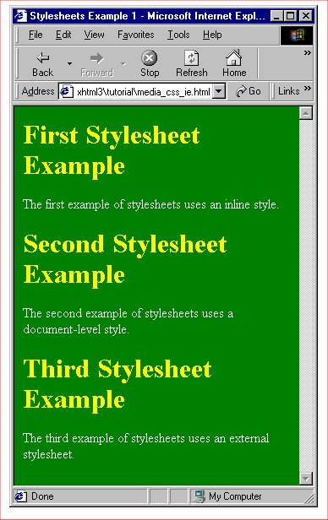
Demonstration:
media_css_ie.html

Slide 22
A more general approach
body {background: green; color: white}
h1 {color: yellow}
@media print
{
body {background: white}
h1 {color: green}
}
General styles will be the default.
print styles will be obeyed by browsers supporting @media (e.g. Internet Explorer), ignored otherwise.

Slide 23
Demonstration:
media_css.html

Slide 24
Style Syntax
A style rule is made up of at least three basic parts:
  Selector
  Property
  Value
The selector is the name of the markup element affected.
Properties and values are paired and enclosed within { }

Slide 25
Basic Syntax
selector {property1:value1; property2:value2; ...}
For example:
  h1 {font-style: italic}
  body {background: red; color: yellow}

Slide 26
Multiple Selectors
Multiple selectors can be combined in a single style rule by separating them with commas.
The following are equivalent:
  h1, h2, h3 {color:green; text-align: center}
  ---------------------------------------------------------------
  h1 {color:green; text-align: center}
  h2 {color:green; text-align: center}
  h3 {color:green; text-align: center}

Slide 27
Contextual Selectors
Rules can be set up so that a style is applied only when a tag occurs in a particular context in the document.
Consider the numbering of an ordered list.
Say we require the first level to be capital letters, 2nd level to be uppercase roman numerals, 3rd level decimals.

Slide 28
Using the type attribute
<ol type="A">
<li>HTML</li>
<ol type="I">
<li>Basic HTML</li>
<li>Advanced HTML</li>
<ol type="1">
<li>Cascading Stylesheets</li>
<li>Image Maps</li>
<li>Forms</li>
</ol>
</ol>
<li>Javascript</li>
<li>Advanced topics</li>
</ol>

Slide 29
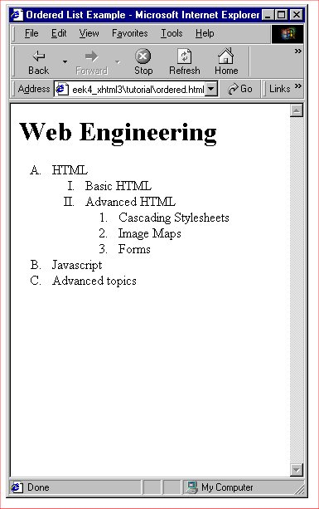
Demonstration:
ordered.html

Slide 30
Using contextual styles
ol li {list-style: upper-alpha}
ol ol li {list-style: upper-roman}
ol ol ol li {list-style: decimal}
The HTML can then be written without the use of the type attribute.

Slide 31
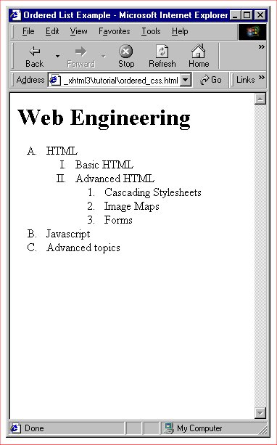
Demonstration:
ordered_css.html
<html><head><title>Ordered List Example</title>
<style type="text/css"> <!-- /* Ordered list formatting */
ol li {list-style: upper-alpha}
ol ol li {list-style: upper-roman}
ol ol ol li {list-style: decimal} -->
</style><head><body><h1>Web Engineering</h1>
<ol>
<li>HTML</li>
<ol>
<li>Basic HTML</li>
<li>Advanced HTML</li>
<ol>
<li>Cascading Stylesheets</li>
<li>Image Maps</li>
<li>Forms</li>
</ol>
</ol>
<li>Javascript</li>
<li>Advanced topics</li>
</ol>
</body></html>

Slide 32
Additional selector patterns
(CSS2 - not yet fully implemented in browsers)
Universal (available in IE5)
  * {color: purple; font:arial}
  Applies the style to all elements in the document.
Child
  ol > li {font-size: 200%; font-style: italic}
  Applies to particular child/parent relationship.
Adjacent
  h1 + h2 {margin-top:+4mm}
  Applies when one tag immediately follows another.

Slide 33
Style Classes
Enables several different styles for the same element.
Distinguished by their class name.
Different types of style classes:
  Regular classes
  Generic classes
  ID classes (limited use - avoid)
  Pseudo-classes

Slide 34
Regular Class Stylesheet
p.red_bold {color: red;
font-weight: bold}
p.red_b_i {color: red;
font-weight: bold;
font-style: italic}
p.green_centre {color: green;
text-align:center}

Slide 35
Using regular classes
<p>This is a normal paragraph</p>
<p class=red_bold>This paragraph is red and bold</p>
<p class=red_b_i>This paragraph is red, bold and italic</p>
<p class=green_centre>This paragraph is green and centred</p>
<p>... and this is normal again!</p>

Slide 36
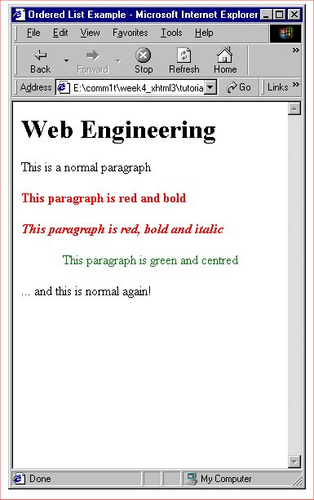
Demonstration:
regular_class_css.html
<html><head>
<title>Ordered List Example</title>
<style type="text/css">
<!--
p.red_bold {color: red; font-weight: bold}
p.red_b_i {color: red; font-weight: bold; font-style: italic}
p.green_centre {color: green; text-align:center}
-->
</style>
<head>
<body>
<h1>Web Engineering</h1>
<p>This is a normal paragraph</p>
<p class=red_bold>This paragraph is red and bold</p>
<p class=red_b_i>This paragraph is red, bold and italic</p>
<p class=green_centre>This paragraph is green and centred</p>
<p>... and this is normal again!</p>
</body></html>

Slide 37
Generic Classes
Allows a class to be defined without associating it with a particular tag.
For example:
  .italic {font-style: italic}
  .bigger {font-size: 150%}

Slide 38
Using Generic Classes
<p class=italic>This paragraph is italic</p>
<h2 class=italic>This H2 heading is italic</h1>
<p class=bigger>This paragraph is bigger</p>
<h1 class=bigger>This H1 heading is bigger</p>

Slide 39
Pseudo-classes
Allows style to be defined for partcular tag states. CSS2 defines 7 but not all are yet supported:
  Hyperlink pseudo-classes:
    a:link
    a:active
    a:visited
  Interaction pseudo-classes
    :hover (IE5 only for hyperlinks)
    :focus
  Nesting and language pseudo-classes
    :first-child
    :lang(??)

Slide 40
Internet Explorer example
<head>
<title>Pseudo-class Example</title>
<style type="text/css">
<!--
a:hover {font-size: 150%}
-->
</style>
</head>

Slide 41
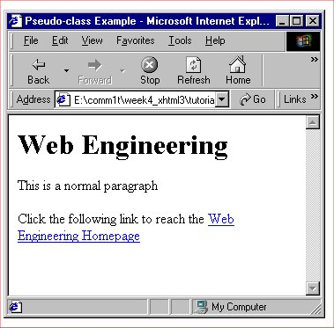
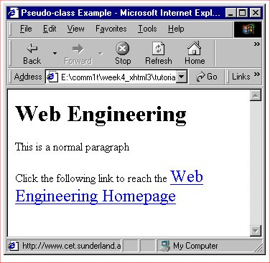
Demonstration:
pseudo_class_css.html
<html>
<head>
<title>Pseudo-class Example</title>
<style type="text/css">
<!--
a:hover {font-size: 150%}
-->
</style>
</head>
<body>
<h1>Web Engineering</h1>
<p>This is a normal paragraph</p>
<p>Click the following link to reach the
<a href = http://www.cet.sunderland.ac.uk/webeng/>Web Engineering Homepage</a></p>
</body>
</html>

Slide 42
Tag-less styles
So far we have modified the style for content within a specified tag.
What happens if we want to modify only part of the tag's contents?
This can be done by enclosing the required content between <span> </span> tags.

Slide 43
Example - style sheet
<head>
<title>Pseudo-class Example</title>
<style type="text/css">
<!--
span {color: red}
span.bigger {font-size: 150%}
-->
</style>
</head>

Slide 44
Example - use of <span>
<p>This text turns to <span>red</span> then back to normal.</p>
<p>This text turns to <span class=bigger>red and is larger</span> then back to normal.</p>

Slide 45
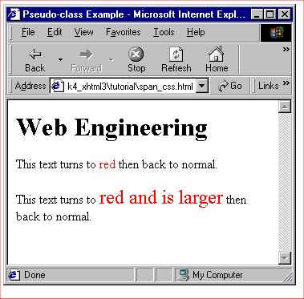
Demonstration:
span_css.html
<html>
<head>
<title>Pseudo-class Example</title>
<style type="text/css">
<!--
span {color: red}
span.bigger {font-size: 150%}
-->
</style>
</head>
<body>
<h1>Web Engineering</h1>
<p>This text turns to <span>red</span> then back to normal.</p>
<p>This text turns to <span class=bigger>red and is larger</span> then back to normal.</p>
</body>
</html>

Slide 46
Property Values
Keyword:
  underline
  small
Length
  absolute e.g. cm, in, mm, pt (1/72 in)
  relative: em (height 'm'), ex (height of 'x')
  pixels: px (size of a pixel on browser's display)
Percentage e.g. font-size:150%
URL e.g. background-image:url(http://xxxx/xxxx.gif)
Colour e.g. color: red, color:rgb(200, 123, 255)

Slide 47
Property Inheritance
A hierarchy of HTML tags exists.
A style applied to a parent tag affects all child tags underneath (unless specifically overridden).
Setting a property for the <body> tag applies that property to all tags in the HTML body, unless they are specifically overridden.

Slide 48
Summary of property types
Font properties
Colour & background properties
Text properties
List properties
Classification properties (tell the browser how to classify tags & contents). Should NOT be modified.

Slide 49
Pros & cons of external styles
Easier to manage for a collection of documents.
Use to pull out common styles.
Easy transfer to other web authors, whether desired or not!
Increase time taken to download page as stylesheet must also be downloaded.
Can become large and unwieldy. Should be managed carefully.

Slide 50
Pros & cons of document styles
Allow external styles to be overridden for a single document.
Use for experimenting/testing out new styles before incorporating into external style sheet.
Require careful management - should you really be using an external style sheet?
As a guide - if a style is required for 3 or more docments, move to an external stylesheet.

Slide 51
Pros & cons of in-line styles
Use only to override more general styles.
Should be used sparingly.
Cannot be re-used.
Management is difficult & error prone.
Consider use of style class definitions instead.

Slide 52
Resources
W3C Tutorial on style sheets
  http://www.w3.org/MarkUp/Guide/Style.html
W3C Home Page for style sheets & further links
  http://www.w3.org/Style/CSS/
Many books!
  These slides were based on Chapter 8 of:
  "HTML & XHTMLThe Definitive Guide", Musciano & Kennedy, O'Reilly.

